Slide 1

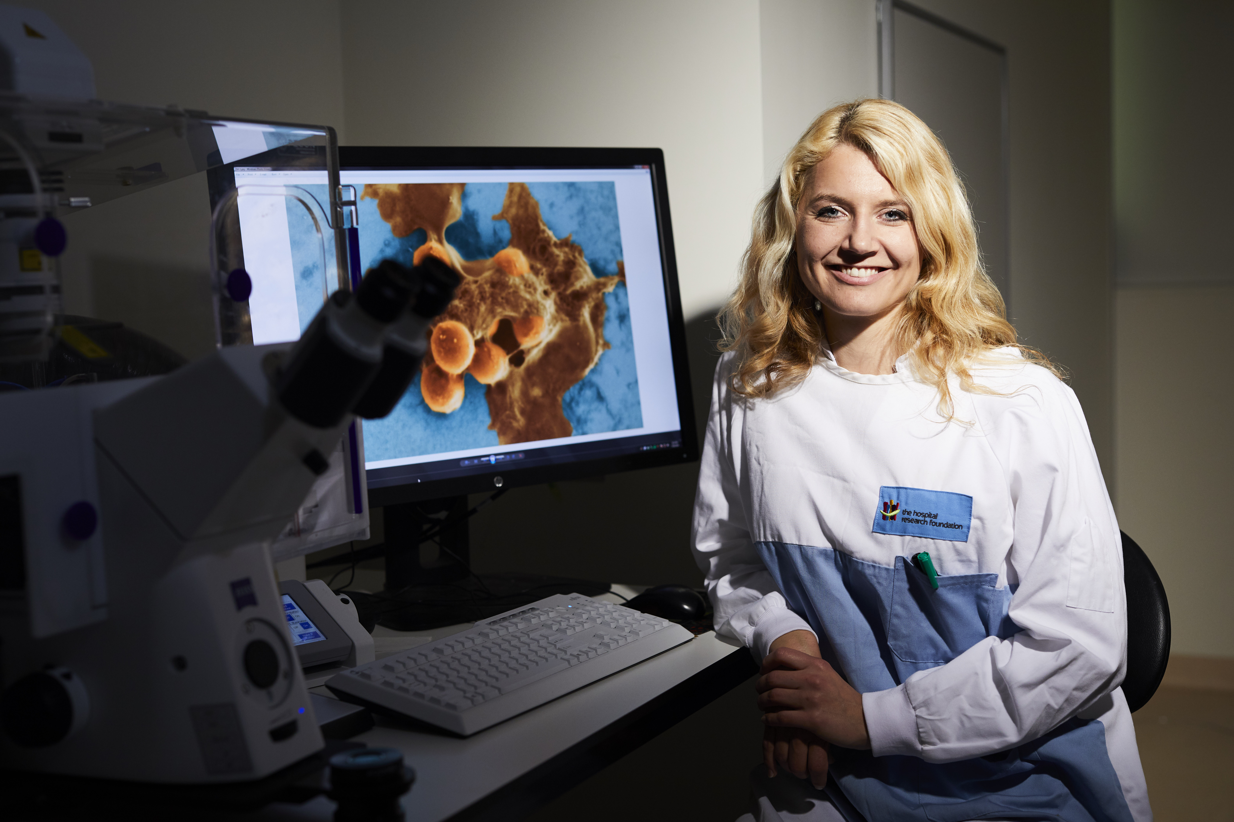
I Work for SA 2021 Survey Results

Slide 2
I Work For SA Survey 2021
Survey Results
Overall Metric Results – DIS & Public Sector
Highest Positive, Neutral & Negative Responses
Highlights
Diversity & Inclusion
COVID Response
Areas of Focus
Next Steps
Notes:
Discussion points for today’s paper for the IWFSA survey

Slide 3
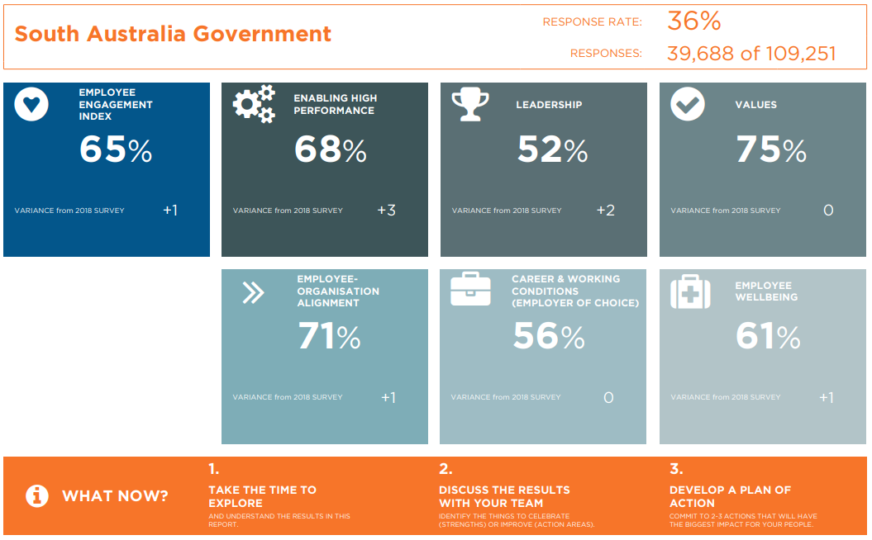
Notes:
Overall Public Sector Dashboard results
An increase in response rate, achieved 36%, up from 18% in 2018.
Slight increase in most metrics from 2018

Slide 4
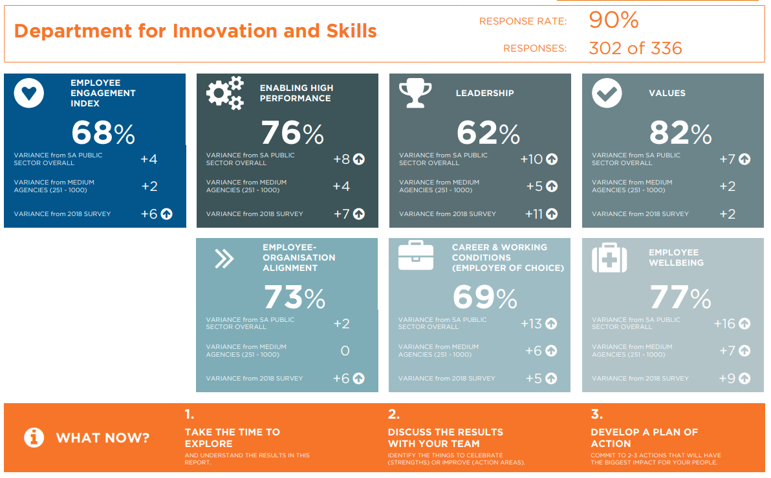
Notes:
DIS Dashboard results
Achieved an increase response rate - 90%, up from 48% in 2018
All metrics had an increase from 2018 and results indicate that DIS results are higher than medium size agencies and the PS.
FYI only – if question is raised. The 2018 IWFSA survey included 5 groups (472 HC) and was open for response while the agency was going through significant change process through the Transformation project. The 5 groups were;
Delivery and Engagement/ Public Projects and Participation
Industry, Innovation, Science and Small Business
Skills and Employment
Strategy and Business Services
Attached Offices (Industry Advocate, Small Business Commissioner and Training Advocate)

Slide 5
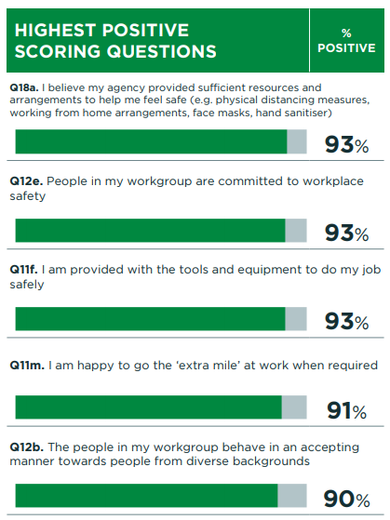
Positive Responses
DIS’s highest Positive Scoring questions fell into the following group or metric;
COVID Response - Q18a
Values Q12e, Q12b
Employee Wellbeing, Q11f
Other (additional questions asked of all SA Public Sector employees)– Q11m
Notes:
Q18a – COVID RESPONSE
Q12e – Values
Q11f – Wellbeing
Q11m – Other question
Q12b - Values
DIS performed strongly in the Values and Wellbeing metrics.

Slide 6
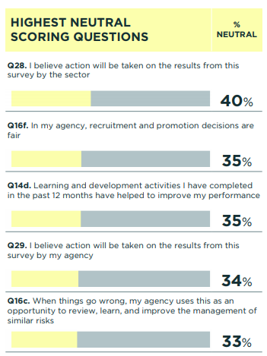
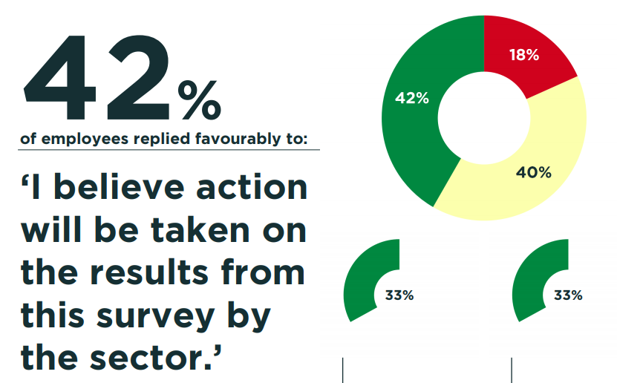
Neutral Responses
Employees who respond ‘Neither Agree nor Disagree' (% Neutral)
This may indicate mixed views or different type of experiences. Could be a potential areas of focus.
Q.28. - Other - 40% neutral, 42%, positive, 18% negative
Q16f. - Leadership - 35% neutral, 47% positive 18% negative
Q 14d. - Enabling High Performance - 35% neutral, 55% positive, 10% negative
Q 29 – Other - 34% neutral, 49% positive, 17% negative
Q16c – Other - 33% neutral, 54% positive, 13% negative
Notes:
Neutral responses are an opportunity for us to focus on engagement and improvement for quicker wins.
It is often easier to move people from neutral to positive than negative to positive.
Important to note that only 40% of our staff believe we will take action on these results, similar to WoG at 42%
We have opportunity to move the neutral responses into the positive experience for staff.

Slide 7
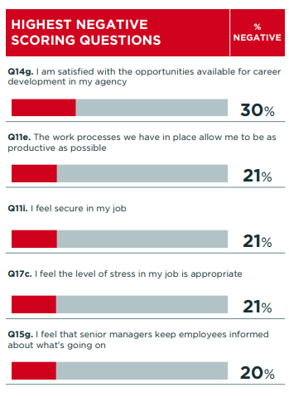
Negative Response
Q14g - Career and Working
Conditions - 28% neutral, 43% positive, 30% negative
Q11e –Employee Organisational Alignment - 24% neutral, 55% positive,21% negative
Q11i – Employee Organisational Alignment - 21% neutral, 58% positive, 21% negative Team reports will be able to identify the key areas of focus
Q17c – Other - 23% neutral 57% positive, 21% negative
Q15g – Leadership – 27% neutral, 52% positive, 20% negative
Notes:
The other three highest negatives scores can be considered when action planning,
Q14g – Explored through the Career and Working Conditions Metric (later in the presentation)
Q11e – Team reports will be able to identify if their respective work processes allow them to be productive where possible. These conversations can be had team level.
Q11i – Opportunity to build and align agency purpose and objectives to empower staff to deliver. This may be something we consider when we develop and identify DIS Strategy & Purpose (and the DIS Professional)
Q17c – although highest negative, it is important to note that 57% agreed stress was appropriate and 23% were unsure. Opportunity to build on our neutral responses to a more positive response. May be delivered through leadership, communication and change management strategies.
Q15g – Explored through the Leadership Metric (later in the presentation)

Slide 8
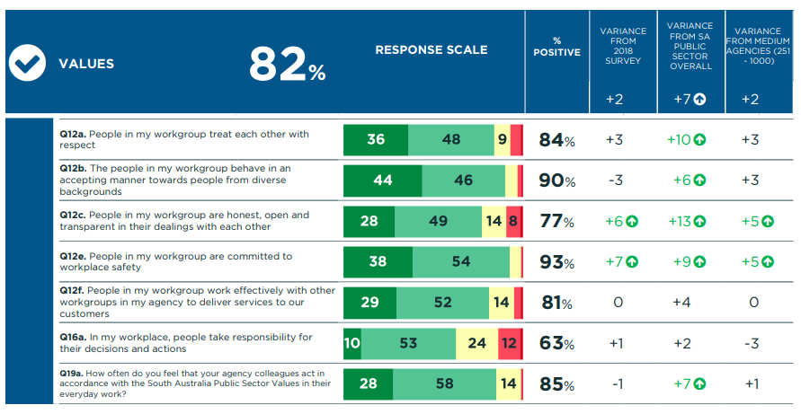
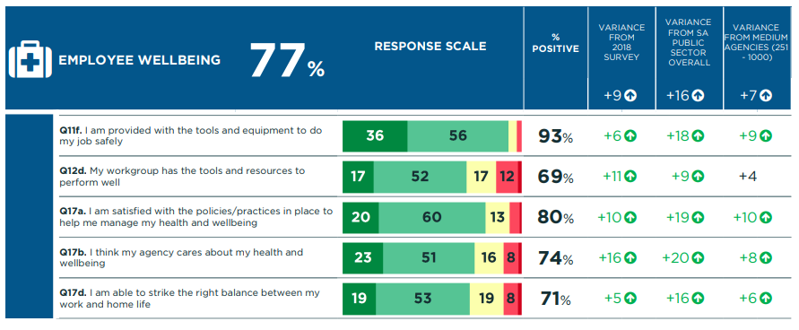
Highlights
Values - driven agency committed to modelling the Public Sector Values.
Employee Wellbeing – employees have the right tools, policies and resources to do their job.
Notes:
The Values index measures the extent to which DIS demonstrate the SA PS Values in day to day work and when collaborating with others.
63% agreed that people take responsibility for their decisions and actions – it is worth noting that only 13% disagreed as 24% were neither disagreed or disagreed with this question.
The Wellbeing score measures the extent to which employees feel supported in maintaining their health and wellbeing.
DIS scores were well above medium agencies and the public sector in this metric. Indicating our wellbeing programs, resources, materials and tools have supported staff to do their job well and get the balance right between work and home life.
11% disagreed that they had the right balance between work and home.
Opportunity for DIS to continue these behaviours and build on what is a solid foundation.

Slide 9
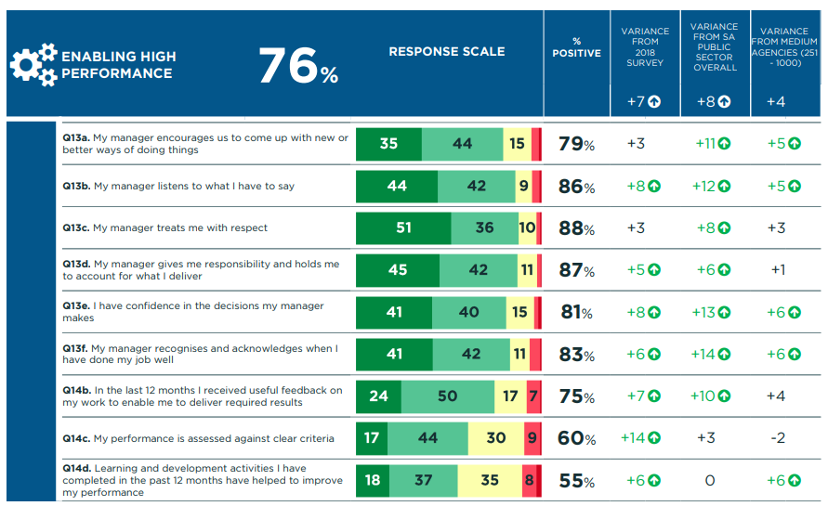
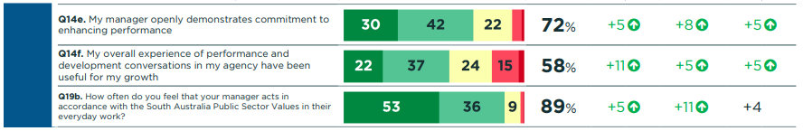
Highlights
Enabling High Performance -
Managers create an environment that enables high performance through recognition, decision making and demonstrating behaviours.
Noting, Learning & Development and Performance Development conversations are an area for focus.
Notes:
The High Performance Index measures the extent to which managers enable high performance within teams through ideas generation, recognition, performance management, feedback and behaviours.
The way managers interact with Team Members has a big impact on individual and team performance.
Our managers / leaders have been able to model the right behaviours to get the most from their teams.
Learning Development (Q14d) and performance development conversations (Q14f) are our lowest scores in this metric. L&D question is also our highest neutral response.
We have seen an increase from 2018, it is worth noting that we can improve / build on current practices.
The SWP will influence the L&D plan/journey for employees (when this program of work is implemented).

Slide 10
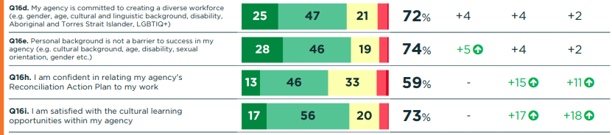
Diversity & Inclusion
Employees agree that DIS is committed to creating a diverse workforce and felt that their personal background is not a barrier to succeed in the agency.
63% agreed senior managers in our agency were supportive of career advancement of women
Notes:
In 2020 the focus for both the C&C Team together with the Stakeholder Engagement and collaborating with Senior Managers has helped DIS achieve a steady growth in results in D&I.
It has also been a focus of the ELT and discussions are now regular.
RAP was launched in 2020 by the CE and the Chair of the WG and Cultural Awareness training commenced in early 2021. DIS’s scores indicate we are leading the way across the PS and other medium size agencies.
Interesting results that Senior Managers were genuinely supportive of career development of women – nothing there was a 10% increase in the score from 2018. We have some work to do in this space and we will be able to investigate/drill down further in the Team reports.

Slide 11
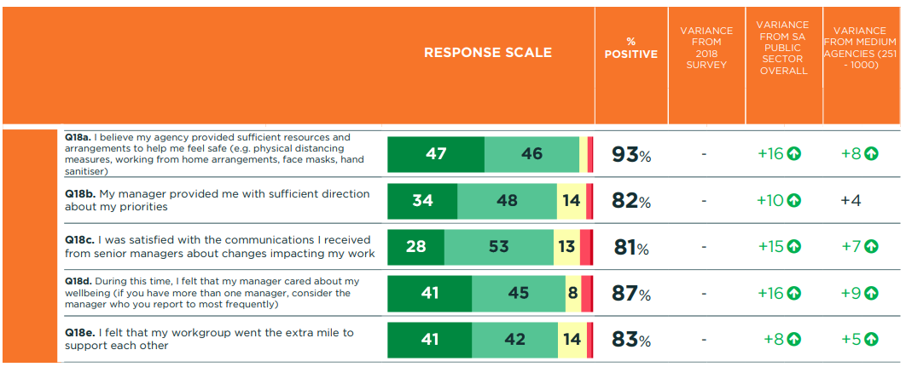
COVID Response
Employees felt supported, that they had the right amount
of communication and direction as a part of the COVID response.
Flexible Working Arrangements have been introduced and staff would like these to continue.
Notes:
Overall COVID response scored 13 points higher compared to SA Public Sector and medium size agencies
Staff spoke positively of the departments response to COVID19 including flexible working however there are concerns of workplace slipping back to pre-covid less flexible arrangements despite policies now in place (from comments on what we are not doing well)

Slide 12
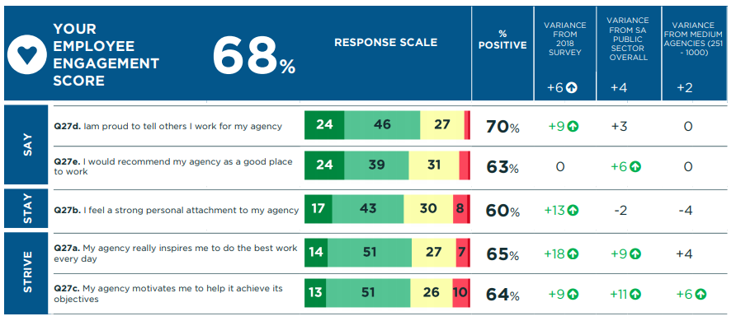
Areas of Focus
Employee Engagement
The results provide a measure of engagement for DIS.
The 5 questions in this metric had 26% or more neither agreed or disagreed responses.
30% were unsure if they had a personal attachment to the agency or would recommend the agency as good place work.
Notes:
The Engagement score tells us the extent to which employees are proud to work at DIS, they would recommend it, intend to stay and strive to go above and beyond. (Say, Stay & Strive)
Again higher than the 2018 survey – DIS has made progress.
40% of DIS employees do not necessarily feel a personal attachment to the agency and 37% of DIS employees would not recommend it as a good place to work. The majority of responses were either neutral or negative to believing action would be taken on the results of the survey.
Many opportunities to build on this metric which could include;
Communication Strategy and sharing how our work at DIS is connected to community and driving business opportunity in SA.
Work to be done to work towards being an employer of choice in the SA Public Sector – ties in with development opportunities, leadership capability, employee recognition etc

Slide 13
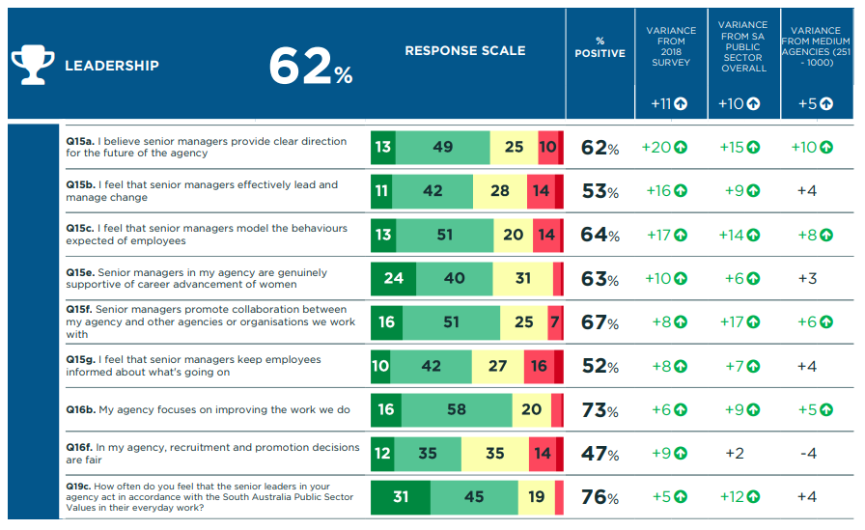
Areas of Focus
Leadership
Increase from 2018. Some focus for our leaders include;
Change Management and
Communication
47% of DIS employees believe DIS recruitment and promotion decisions are fair. This was DIS highest neutral score (35%).
20% feel employees are NOT kept informed by Senior Managers. This was one of DIS highest negative scores.
Notes:
The Leadership Index measures perceptions of how effectively senior leaders (i.e. Directors and ED) communicate their vision for the agency, enable advancement and inspire people through their actions and behaviours.
DIS had an significant increase in responses when compared to the 2018 survey.
Note
Question 15g was one of DIS highest negative scoring questions.
Question 16f was one of DIS highest neutral score questions
Change Management
Change Management Training commenced late 2021 and the Change CoP will help address change skills amongst senior managers
Leadership with Steve Lacey/Leading Teams should help address some areas
Communication
Senior Managers at only 52% for keeping employees informed about what is going on – Internal Communications Strategy may assist with this

Slide 14
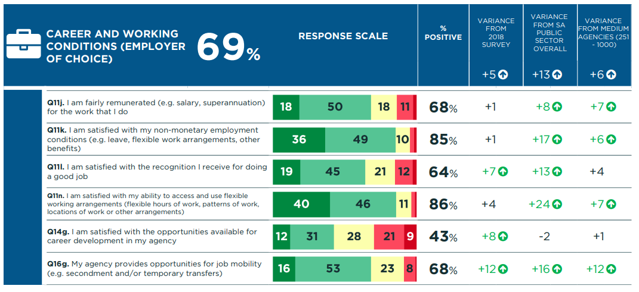
Areas of Focus
Career and Working
Conditions (Employer of
Choice)
Staff feel that there are not enough Opportunities for career development at DIS.
This was DIS highest negative score (30%).
Notes:
The Career and working conditions index indicates how satisfied people are with the career and working condition of the PS.
Overall a good response from DIS. Of particular note/discussion is Q14g.
Q14g – I am satisfied with my opportunities available for career development in my agency was DIS’s highest negative score at 30% and further 28% unsure. Although increase from 2018, this would be a key area of focus in this metric.
Recognition has improved and was identified as a area of focus in 2018 and could be an area of focus again in 2021.

Slide 15
Next Steps
OCPSE IWFSA Whole of Sector Action Plan development in September
DIS IWFSA Survey 2021 Action Plan
Review the DIS People Plan to ensure IWFSA Actions are reflected
People and Culture Committee for review and endorsement

